Slide 1
Hyperbole and a Half: Unfortunate Situations, Flawed Coping Mechanisms, Mayhem, and Other Things That Happened Allie Brosh
Engracia Bautista
Randi Brady
Kara Duggan
Colton Jones
Megan Jones

Slide 2
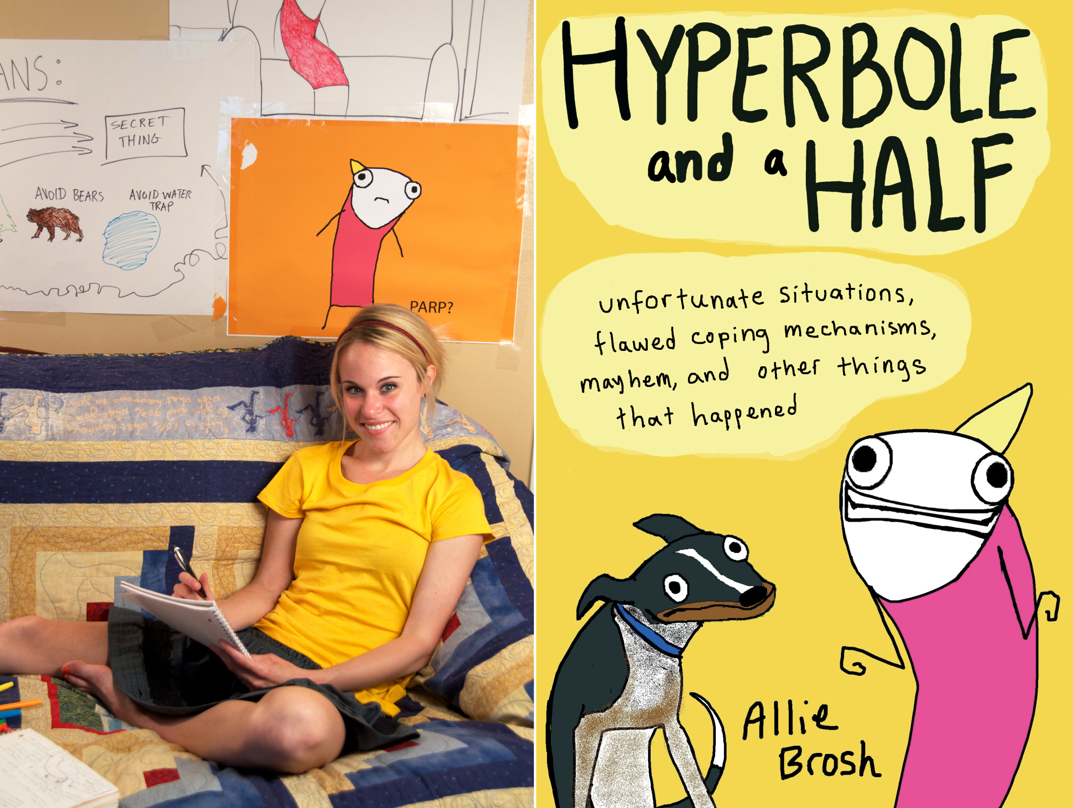

Slide 3
Web Comedian, Blogger, Novelist, & Grammar Nazi
Allie Brosh’s Hyperbole and a Half is a retelling of her life through rage comics and narration, which includes stories from her childhood and the challenges of adulthood.
The blog expanded to a series of web videos and finally, a novel (released in October 2013).
Rage comics are rather simple: basic diction and simple art (she composes her art work on the Paintbrush program).

Slide 4
The Topics:
Brosh writes on the effects of ADHD and depression on her personal interactions with the world.
She dedicates posts in her website and her novel to depression and offers a unique insight into what sufferers of depression encounter on a regular basis.
She integrates serious subject matter through bouts of comedic relief.

Slide 5
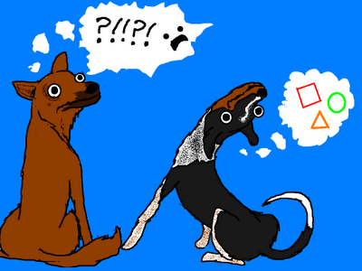
The Topics:
She also spends a great deal of time discussing the challenges of training her dogs and chronicles her home being invaded (although in the novel, the brigand was a goose)

Slide 6
How is this English-Content related?
Good question.
She made herself a well-known artist/author through her FREE blogspot account and is using her platform to inspire and teach others.
Graphic novels and blogs are becoming a reputable, respected form of self-expression that have the audience and following of avid book readers.
She’s been popularized by various meme’s that adolescents, in particular, really enjoy.
And she is terrified of the ways in which internet use and text-messaging has mangled the English language.

Slide 7
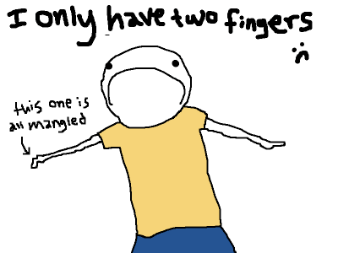
A few Coping Mechanisms
When people type “u” instead of “you”… this is what Allie Brosh thinks:
“Instead of getting mad, I imagine them having only one finger on each hand and then their actions seem reasonable. If I only had one finger on each hand, I’d leave out unnecessary letters too!”

Slide 8
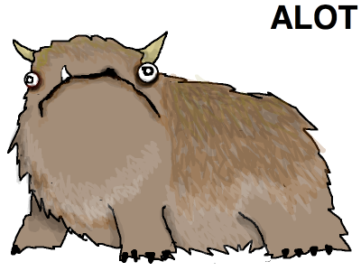
Content-based Lesson

Slide 9
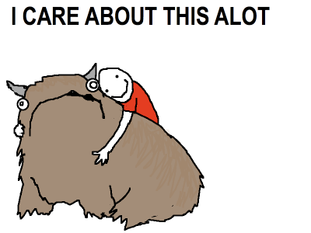
For example, when I read the sentence "I care about this alot," this is what I imagine:

Slide 10
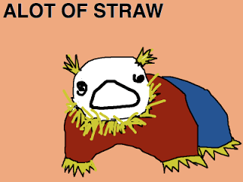
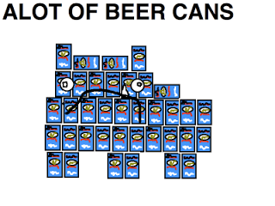
Similarly, when someone says "alot of _______", I picture an Alot made out of whatever they are talking about.

Slide 11
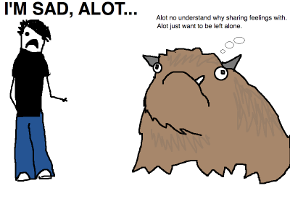

Slide 12
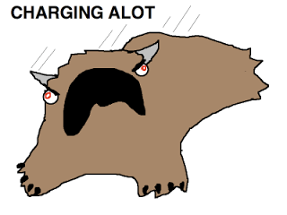
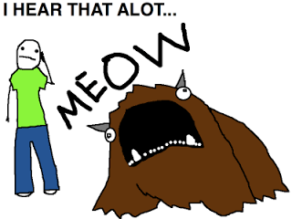
The Alot is incredibly versatile.

Slide 13
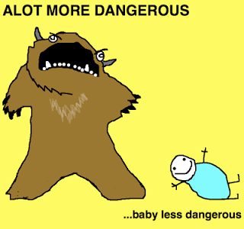
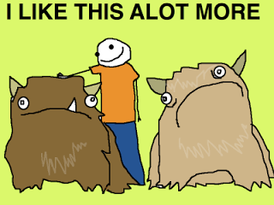

Slide 14
Assignment for Students (and you!)
This graphic novel could be used as the gateway to introspective writing, namely memoir composition.
While reading this novel, students should be able to identify the ways in which Brosh is an effective storyteller.
Great memoirs include: action, dialogue, retrospective thinking, imagery that evokes the five senses.

Slide 15
GREAT MEMOIRS INCLUDE: | FOR MY MEMOIR:
ACTION: I shivered with anticipation as Miss Charlotte, the crusty, old, and senile librarian pulled out my favorite children’s book, Corduroy.
DIALOGUE: “Miss Charlotte, you said it wrong! I remember its Corduroy’s buttons, NOT his buttons. That’s wrong!” I shrieked at the poor, terrified librarian.
A THOUGHT, QUESTION, or FEELING: As I felt the heat from my mother’s rage make its way over to me, I knew my cover as an expert four-year-old reader was over. I wondered what else could possibly go wrong.
IMAGERY and FIGURATIVE LANGUAGE: Clash! You could hear a pin drop on the carpeted, rainbow carpet. All eyes were on me, I could feel my tear ducts welling up.

Slide 16
Memoir Modeling
Memoirs capture a moment in time and incorporate strong diction, imagery, and a writer’s presence to make the experience relatable for the audience.
In addition to Allie Brosh’s Hyperbole and a Half, it would be ideal for a teacher to use an example of a more conventional memoir for students to model their writing.

Slide 17
Sample of a Memoir
Growing up as a gangly, awkward, bookworm had its severe disadvantages. Of course, my outlook on life when I was in 5th grade toward those who chose to give me a hard time went something like: “Who will be laughing when I’m your boss someday?” Sadly, those girls probably wouldn’t make it into the work force because they’d be some trophy wife to a successful banker or attorney, so there went my argument. I was forced to suffer through each day of 5th grade because I had a gap tooth, I wasn’t wearing grey New Balance tennis shoes at P.E., and I wasn’t a part of the in crowd. Despite my abhorrence toward school, there was one bright spot in my day. Brady was my obvious crush—I wasn’t too good at masking it. I couldn’t speak clearly around him and there was that time where my language arts teacher intercepted a note meant for him and read it to the entire class. But that news had mulled over since the latest gossip involved a guy peeing his pants in gym, so I was definitely off the hook.
At Brookstone Middle School, status was the money carried in your designer bag, the car your mom picked you up in after school, and the clothes on your body. Thankfully, we were all resigned to eating lunch in the cafeteria with our grade-level, so I didn’t sit alone—there were people maybe five or six seats away from me. I was within earshot of the incessant jokes, the hurtful jeers at my lack of style or my obvious preparation for a flood because my jeans weren’t long enough, and my pain was constant.
On March 6th, lunchtime had been rather bland—it was Taco Tuesday. You get your choice of a soft or hard taco with beef or chicken. When you go put your tray down at your designated seat—you could go get your drink and whatever you wanted to accompany your lunch (lettuce, cheese, or salsa). This was designed in hopes of eliminating messes by carrying too much, we were middle schoolers after all—awkward in design. When I returned to my lonesome tray with my generous helping of sour cream, shredded lettuce, and cheese, I hear the snorting sound of suppressed laughter coming from about ten seats away from me. Assuming it was my faded t-shirt or last year’s style, I just went about my business. I was pretty good about hiding any anger or hurt while I was at school. After about halfway through my lunch, the snorts turn to snickers and finally into hoots and all out laughter. Tears are welling up in my eyes and I say to myself, “Hold it in, Megan. You’re better than this.” But as a pot of boiling water, the irritation and hurt bubbled over and I finally yelled at them: “What in the hell are you laughing at!?” The leader of the pack of well-dressed, rich girls boldly confessed that while I was getting my side dishes and milk, they had taken turns spitting into the tortilla that I had just finished eating. She finishes her explanation with an accusation of “loving to swap spit with other girls…can’t wait to hear what Brady will think.” Brady?! Really? Wasn’t it already painful enough that he knew I liked him, but now he was going to be told that I had “swapped spit” with a bunch of girls?! I couldn’t hold back my tears—I ran out of the cafeteria crying so hard I could barely see. I knew I couldn’t tell—because that was a death sentence I wasn’t ready to face. To this day I still never told my mom or dad in fear of what they would have done. It would have been even more embarrassing to watch my dad tear through my school in rage looking for the accused perpetrator of my discontent. I’m not sure if he would have beat the girls up or have gone to their houses looking for their parents to tell them what hell-sent brats and spawns of Satan their children were. To this day, I’ll never forget the awful things that happened to me in 5th grade and have gone out of my way to not make fun of people because no one deserves to feel the way I felt that day.

Slide 18
Acclaim for Hyperbole and a Half
Hyperbole and a Half began life as Allie Brosh's blog, full of crude sketches and absurdist rants about spelling, dogs, cake and the pressures of adulthood. But there's a serious side as well, in heartfelt, unsparing stories about her struggle with depression
NY Times Bestseller
Barnes and Noble Bestseller
NPR Nonfiction Bestseller
http://www.nytimes.com/video/books/100000002552956/hyperbole-and-a-book.html

Slide 19
As educators, we need to realize…
That technology has made other forms of media possible and we need not discourage students from holding graphic novels, blogs, and alternate forms of literature as less than a regular ole’ book.
That valuable lessons (and yes, the a lot/alot discrepancy is a valuable lesson in the eyes of an English teacher) can be found in unique ways
Today’s adolescents are different from us when we in school—and that’s not an excuse for their behavior or general weirdness—but a challenge for teachers to foster their curiosity, and use the things that interest them to inspire students to perform in your classroom.

Slide 20
Universal Theme: Never Give Up!

Slide 21
The end!

